Slide 1
9a.2
An Ultra-compact D-band SiGe Low
Noise Amplifier for Array Integration
Jonathan Tao, Matthew Tom, James F. Buckwalter
University of California, Santa Barbara
UC Santa Barbara Santa Barbara, California 93106

Slide 2
Outline
Motivation
Design
Results
Conclusion

Slide 3
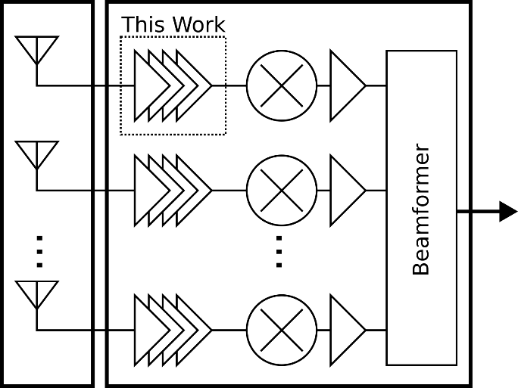
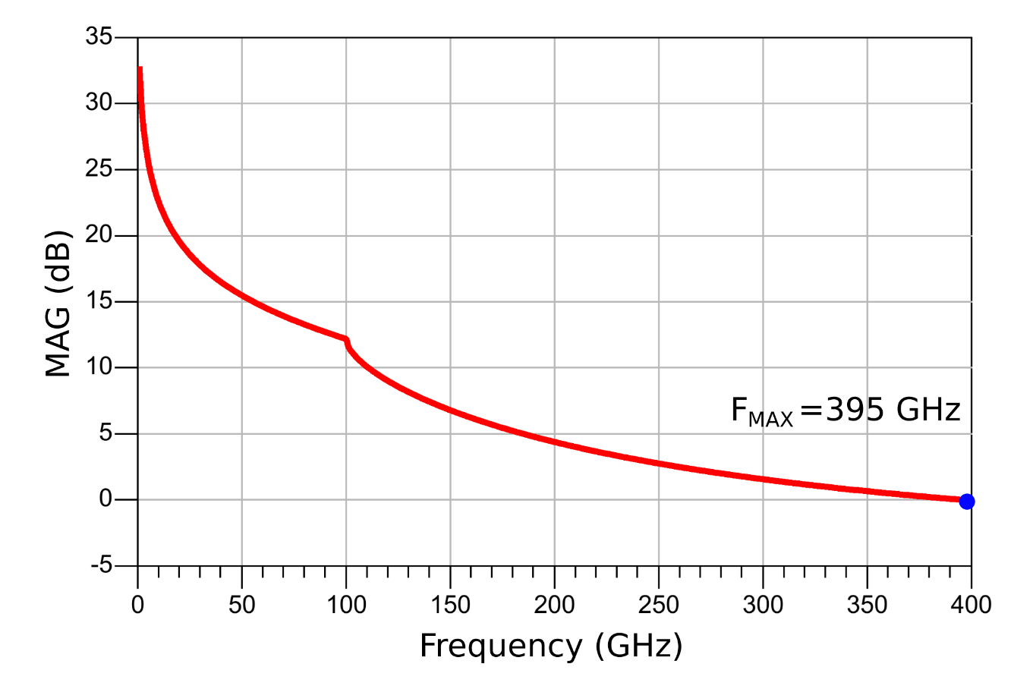
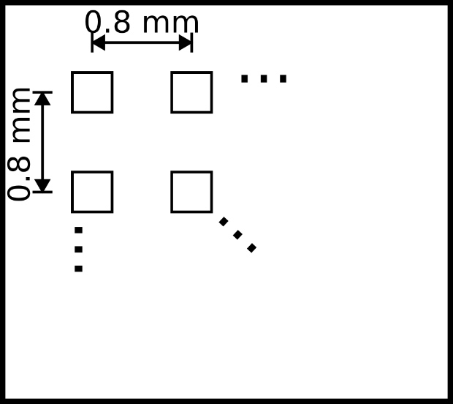
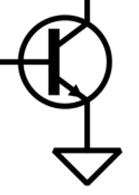
Motivation
Wide spectrum availability in frequency bands from 30 GHz to 300 GHz
Want a compact LNA to cover D-band (110-170 GHz) that fits in array receiver system
Array receiver system for integration
90-nm SiGe BiCMOS
Global Foundries 9HP+
0.1x2 um Emitter
4 mA
Half-wavelength tiling at 170 GHz
Notes:
Area with tiling
Example system
Extract best noise measure performance while maximizing gain with the available area
Technology: 90-nm SiGe 310/370 GHz ft/fmax

Slide 4
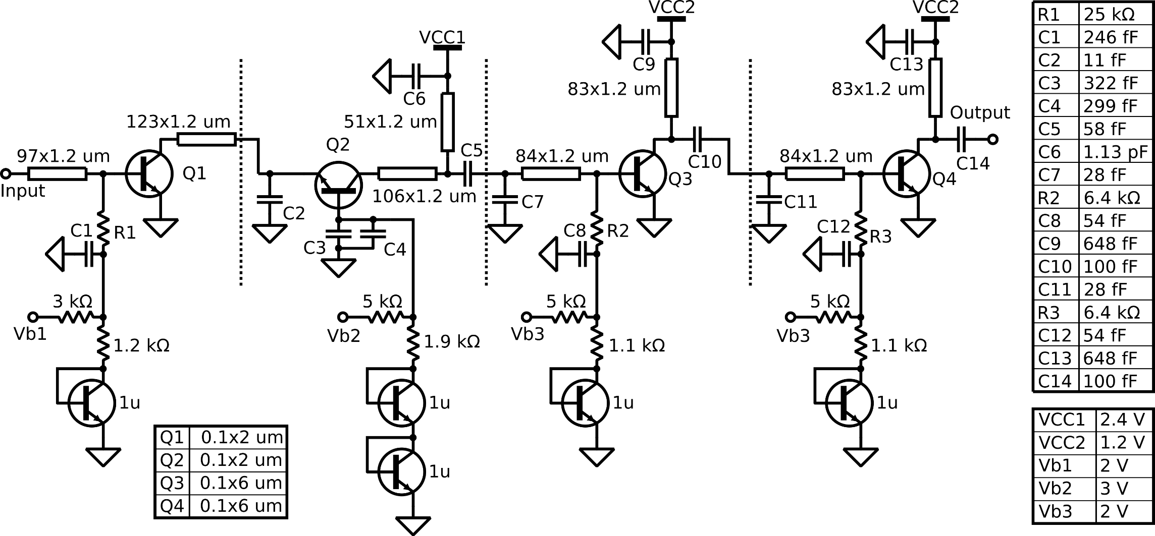
Schematic
Proposed 4-stage LNA
90-nm SiGe BiCMOS (Global Foundries 9HP+)
Notes:
Bias networks

Slide 5
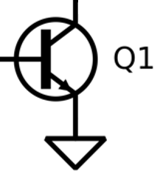
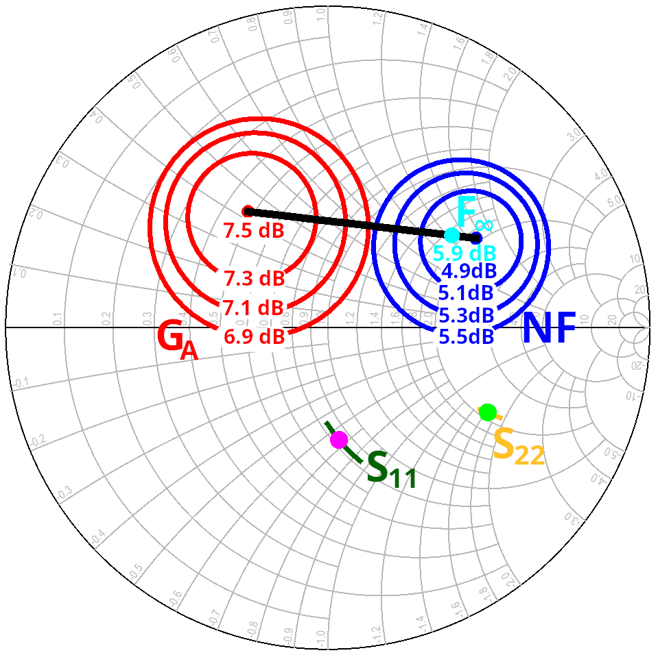
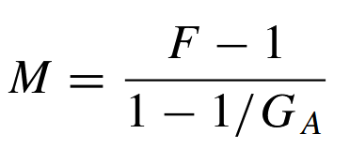
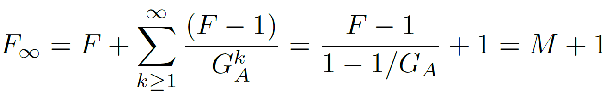
Design
First Stage (Common Emitter):
Design for best noise performance and broadband input matching
Sized to get base impedance 42.8- j59.6 Ω at 140 GHz for easy input matching
Use noise measure (as F∞) for matching
4 mA collector current (2 um emitter)
Impedances of Unmatched First Stage Transistor (140 GHz)

Slide 6
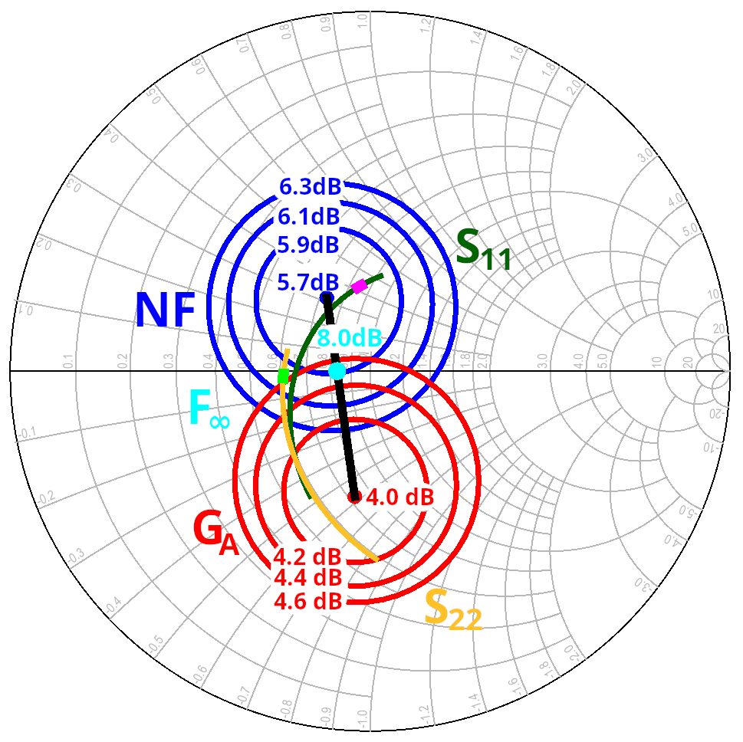
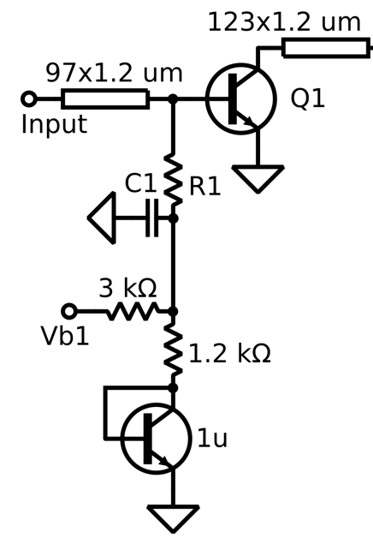
Design: First Stage Noise and Gain
Minimum noise measure impedance match at 158 GHz.
Match at higher frequency to make the most of lower gain and higher noise
Stagger tuning between S11 and S22 for next stage to peak the gain at higher frequencies
Input and output impedances are shown from 110-170 GHz with 158 GHz marked.

Slide 7
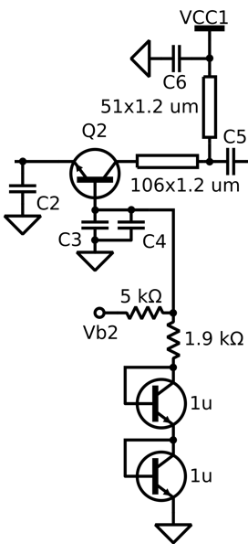
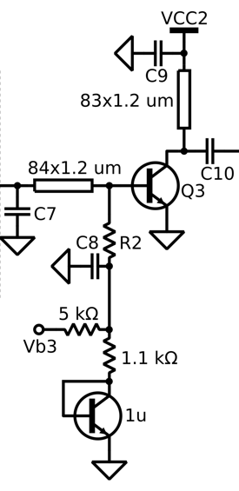
Design
Second Stage (Common Base):
Design for high frequency gain peaking with staggered match at high frequency
Reuses current provided to first stage without DC block to save space and power
4 mA collector current (2 um emitter)
Third/Fourth Stage (Common Emitter):
Designed to increase output power and to provide additional gain with available space
9.4 mA collector current (6 um emitter)

Slide 8
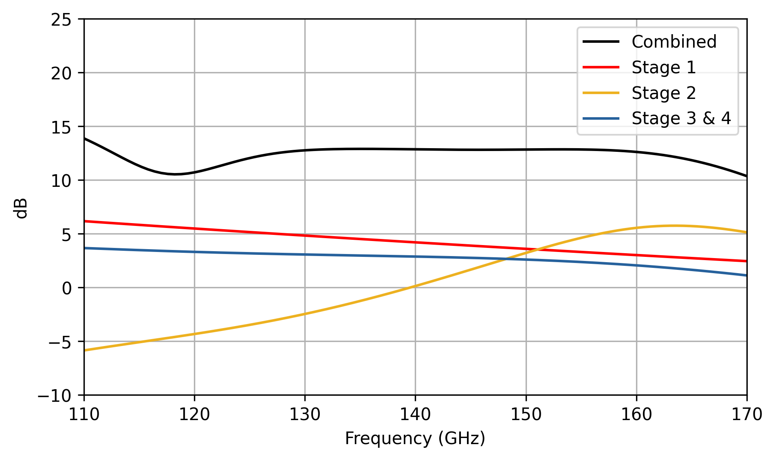
Design: Gain per Stage
Simulated gain per stage contributions with staggered tuning and combined gain of full 4-stage LNA.

Slide 9
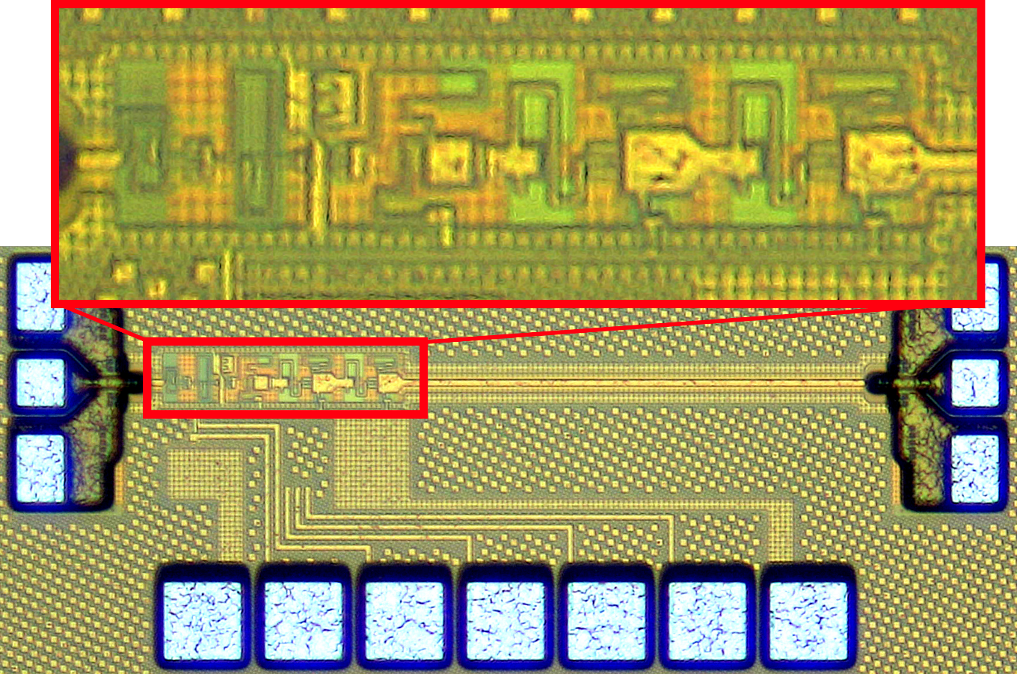
Micrograph
LNA test structure with output extension
Includes 450 um line for probe clearance
Not de-embedded from measurements
Measured loss ranges from 0.5 dB to 1.7 dB, and return loss > 14.6 dB
Chip dimensions:
395 um x 975 um
LNA core dimensions:
60 um x 245 um
0.015 mm²

Slide 10
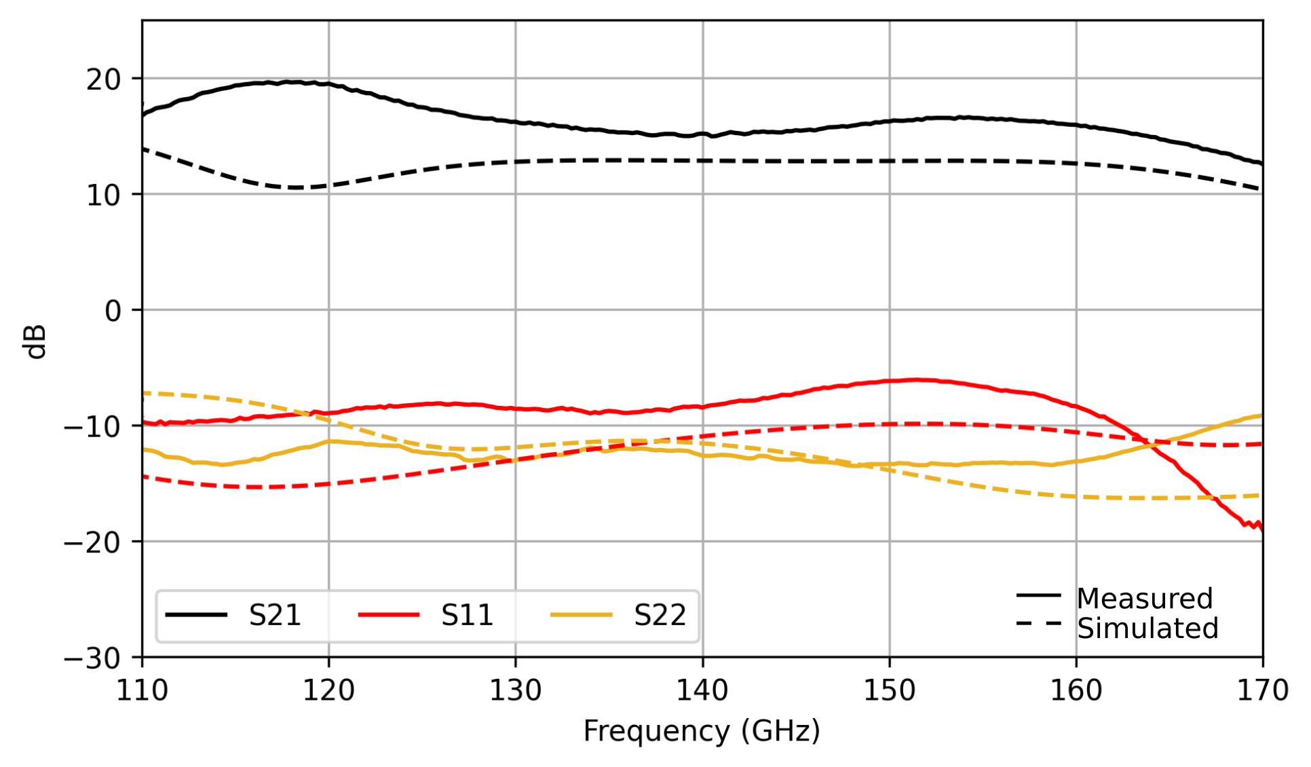
Results: S-Parameters
Gain > 12 dB across D-Band
Maximum gain: 19.7 dB at 118 GHz
3-dB Bandwidth from 123 GHz to 164 GHz

Slide 11
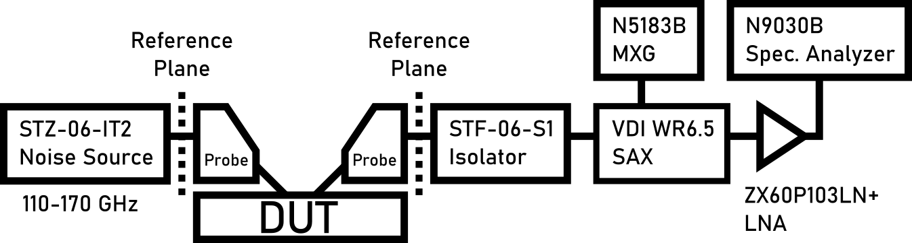
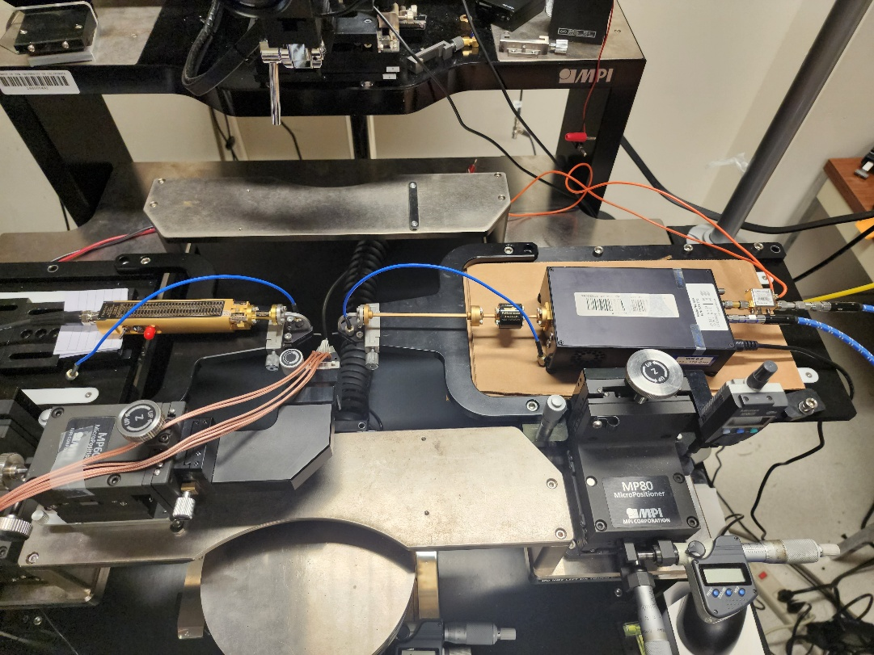
Noise Measurement Setup
Y-factor measurement
ENR ~15 dB
1 GHz IF with 240 kHz RBW
Probes loss was removed from noise measurement by calculation
Probe loss was obtained with back-to-back scalar measurement

Slide 12
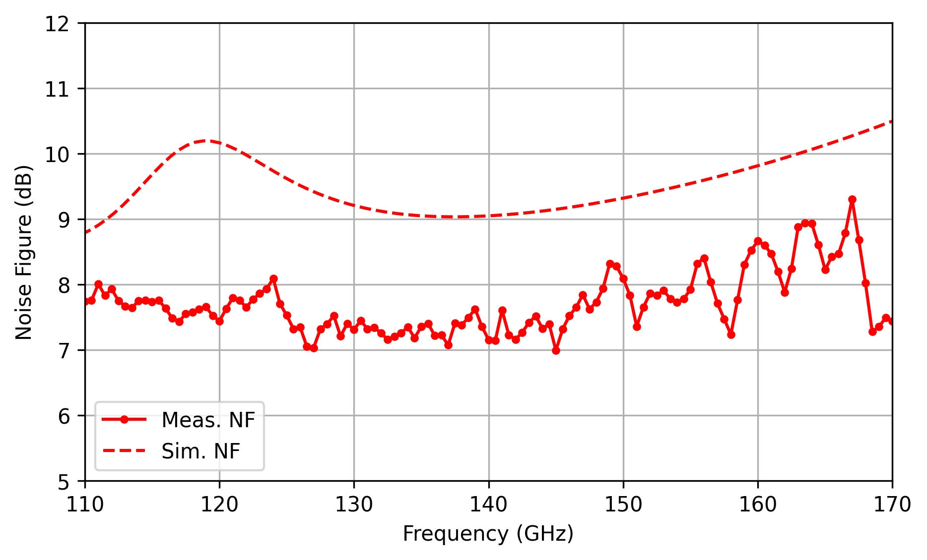
Results: Noise Figure
NF < 9.3 dB across D-band
Lowest NF: 7.0 dB at 145 GHz
Monte Carlo on variation with noise figure (140 GHz):
Standard Deviation: 0.4 dB
Noise Measurement Uncertainty (140 GHz):
0.7 dB over 2σ

Slide 13
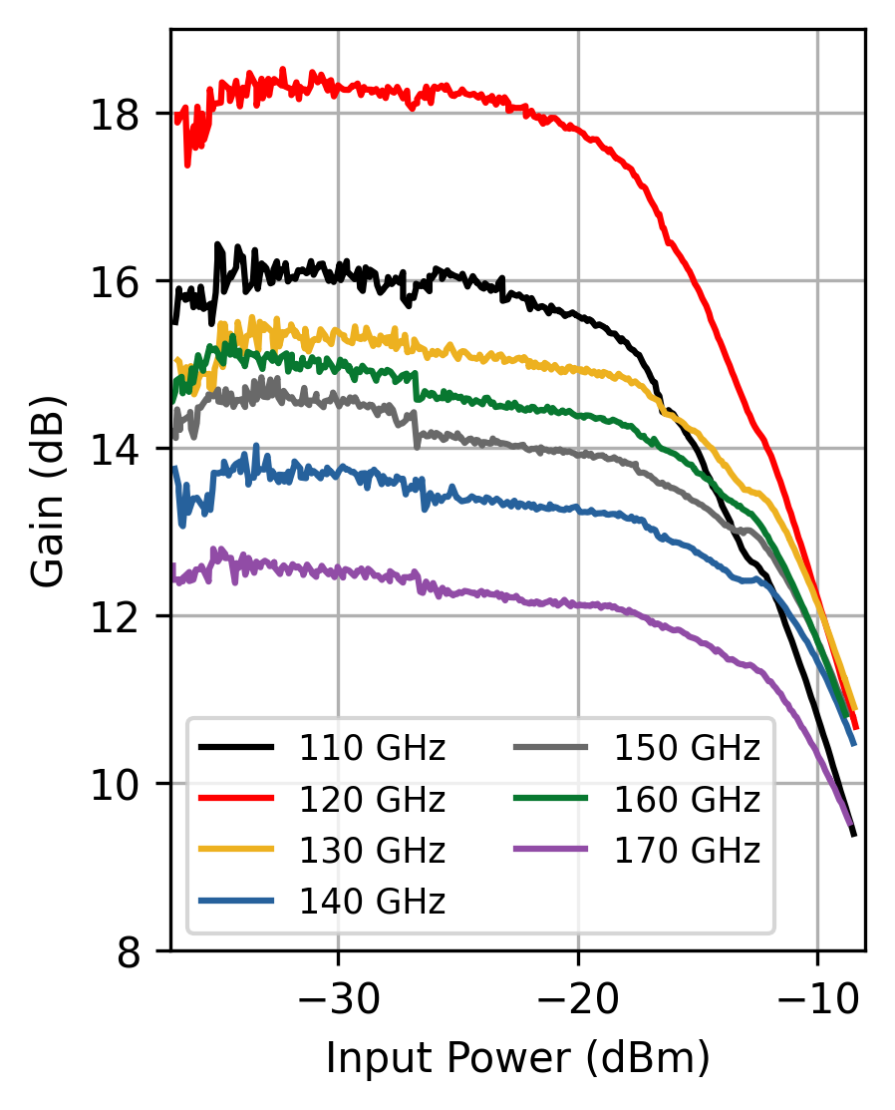
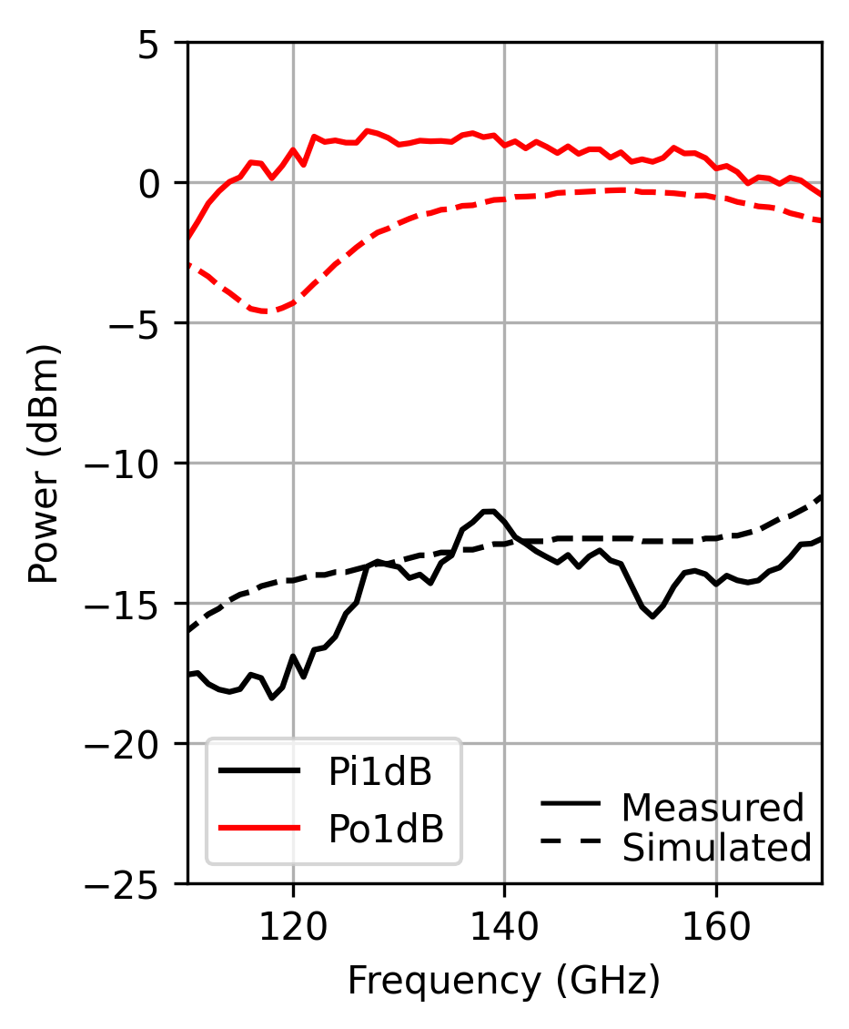
Results: Power
Small signal gain is consistent with S-parameter measurements
1-dB input compression ranges from -18.4 dBm to -11.7 dBm
Input Power Sweep
Compression Points

Slide 14
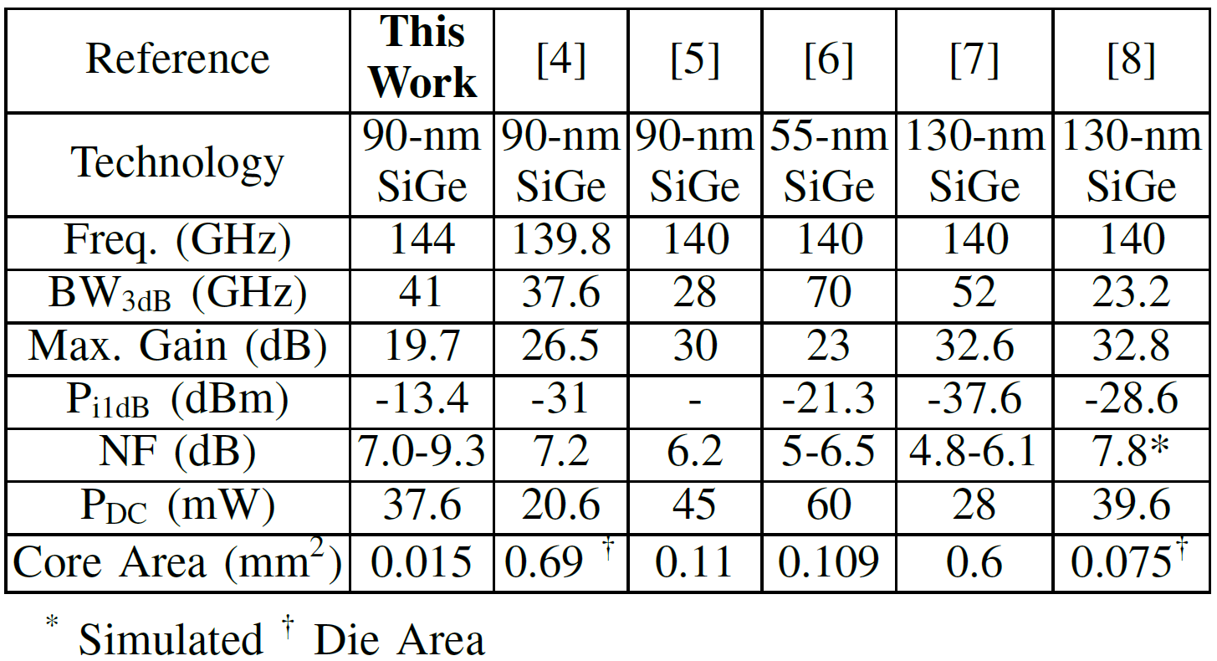
Conclusion
The LNA uses staggered tuning with optimum noise measure matching to achieve performance in record area consumption.
Its small size of 0.015 mm² makes it suitable for highly scaled receiver systems.

Slide 15


Acknowledgements
This work was supported by the Semiconductor Research Corporation (SRC) under the JUMP program, Cognisense
The authors appreciate the support of GlobalFoundries for access to the 9HP+ process.

Slide 16
Comparison Table References
[4] A. Moradinia, S. G. Rao, and J. D. Cressler, “A sige hbt d-band lna utilizing asymmetric broadside coupled lines,” IEEE Microwave and Wireless Technology Letters, vol. 33, no. 6, pp. 707–710
[5] R. B. Yishay, E. Shumaker, and D. Elad, “A 122-150 ghz lna with 30 db gain and 6.2 db noise figure in sige bicmos technology,” in 2015 IEEE 15th Topical Meeting on Silicon Monolithic Integrated Circuits in RF Systems, 2015
[6] G. D. Filippi, L. Piotto, and A. Mazzanti, “A d-band lna exploiting ultrawideband sixth-order matching networks in sige bicmos,” in 2024 IEEE European Solid-State Electronics Research Conference (ESSERC), 2024
[7] E. Turkmen, A. Burak, A. Guner, I. Kalyoncu, M. Kaynak, and Y. Gurbuz, “A sige hbt d -band lna with butterworth response and noise reduction technique,” IEEE Microwave and Wireless Components Letters, vol. 28, no. 6, pp. 524–526,
[8] E. Aguilar, A. Hagelauer, D. Kissinger, and R. Weigel, “A low-power wideband d-band lna in a 130 nm bicmos technology for imaging applications,” in 2018 IEEE 18th Topical Meeting on Silicon Monolithic Integrated Circuits in RF Systems (SiRF), 2018

Slide 17
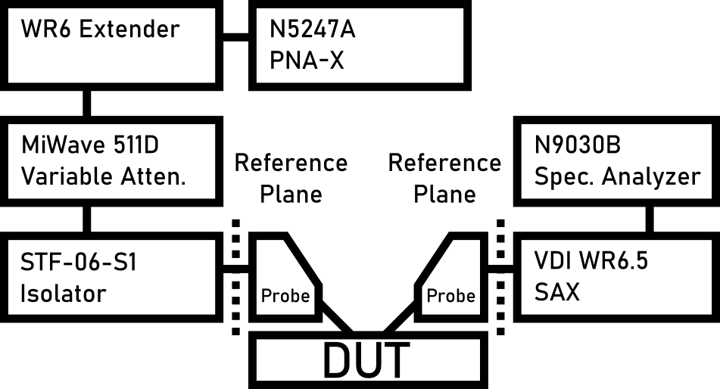
Power Measurement Setup
Use variable attenuator to change power level
Better extender performance at saturated power
Better linear control over power level
Calibrate input powers at all frequencies and attenuations with power meter
Use calibrated input chain to calibrate down-conversion

